Slide 1
BIG MOUNTAIN RESORT PROJECT

Slide 2
Problem Identification
With an annual guests of 350,000 and a state-of-the-art facilities, Big Mountain Resort cannot maximize its returns.
The revenue shortfall can be attributed to:
The ticket price, that was based on a pricing strategy that used the average price of resorts in its market segment.
Operating cost.

Slide 3
Recommendation and Key Findings
To avert the revenue problem of Big Mountain Resort, the current ticket price was adjusted based on the facilities that matter most to visitors using a pricing model.
The following facilities were selected as the most important by the model for the ticket price prediction: ’vertical drop’, ‘Snow Making_ac’, ‘total_chairs, ‘fastQuads’, ‘Runs’, ‘LongestRun_mi’, ‘trams’ and ‘SkiableTerrain_ac’.
As a result of the facilities above, four scenarios were shortlisted for modeling. Scenario 2 emerged as the optimum for the ticket price prediction. The reason was, it supports a ticket price increase and returns a price delta of $8.61, amounting to $15,065,471.
Based on the optimum scenario, Big Mountain Resort should add a run, increase the vertical drop by 150 feet, and install an additional chair lift.

Slide 4
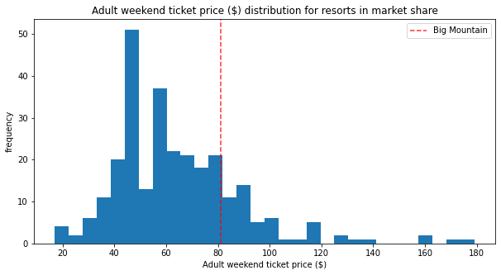
Modeling Results and Analysis
After considering a couple of models to predict the ticket price, the random forest regressor was chosen because of its better performance.
The actual price of ticket currently charged by Big Mountain Resort is $81.00. A price of $95.87 was predicted by the random forest regressor. This was a clear indication of ticket price being undercharged. Fig.1 shows where big Mountain sits among all resorts for pricing.
Fig.1

Slide 5
Modeling results and Analysis
Although a price of $95.87 was predicted, it was adjusted using the four shortlisted scenarios, for revenue maximization.
Scenario 1: closing 10 runs; scenario 2: adding 1 runs, 150 feet vertical drop and I chair lift; scenario 3: scenario 2 + adding 2 snow making_ac and scenario 4: adding 0.2 mile longest run and 4 snow making_ac.
According to the model, scenario 4 returned zero price delta.
Both scenario 2 and 3 increases support for ticket price and so predict a positive price delta. However, the small increase in the snow making area in scenario 3 made minimal difference. Hence, scenario 2 was the optimum.

Slide 6
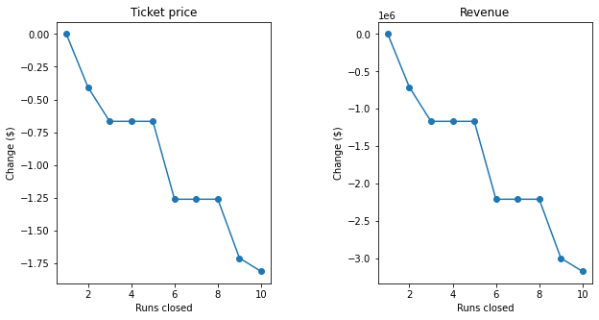
Modeling results and Analysis
In the case of scenario 1 there was no support for ticket price and revenue increase. Closing 1 run makes no difference, closing 2 and 3 reduces support for ticket price. If 3 is closed, 4 or 5 can also be closed without any further loss in price. Increasing the closures to 6 or more leads to a large drop. Fig.2, shows the trend in the closures.
Fig.2

Slide 7
Summary and Conclusion
The model predicted the ticket price on the basis that the expected number of visitors over the season was 350,000 and, on average, visitors ski for five days.
Since the optimum scenario increases ticket price by $8.61 and the price predicted before considering the scenarios is $95.87, conclusion can be drawn that a ticket price of $104.48 is what the model suggests for Big Mountain Resort based on the facilities.
For a predicted ticket price of $104.48, Big Mountain Resort, can generate enough revenue to cover the operating cost ($1,540,000) of the additional chair lift installed for a season.

